Slide 1
Biological Therapy
Ahmed R. Al-Agamy
Assistant Lecturer of Rheumatology
Sohag University
2013

Slide 2
Introduction

Slide 3
Biologic Response Modifiers
Biological response modifiers, also known as BRMs or biologic DMARDs or Biologics
  Alter the human body’s natural process
  Commonly affect cell to cell messaging
  Networks used by almost all of the systems
  Lead to either blocking of or increase in the process it is affecting
  Variety of Uses - treat arthritis, cancer, and some other diseases.

Slide 4
Biologics - Types
Cytokines – Replacements or alterations
- Interferons, interleukins
Receptor modulators- Blockers or stimulators
- Etanrecept, alefacept
Monoclonal Antibodies - Blockers or stimulators
- Adalimumab, infliximab

Slide 5
Nomenclature

Slide 6
Nomenclature- Guidelines
“RECEPT” = Receptor affecting molecule
“MAB” = Monoclonal antibody
  Iximab = chimeric monoclonal antibody.
  Zumab = humanized monoclonal antibody.
  Mumab = fully human monoclonal antibody.

Slide 7
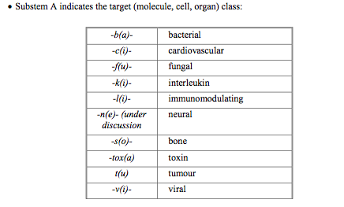
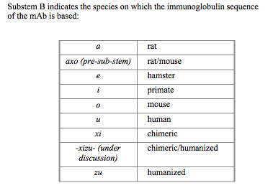
Monoclonal Antibody Nomenclature
A prefix -random, substem A, substem B and common suffix here is “MAB” = Monoclonal antibody

Slide 8
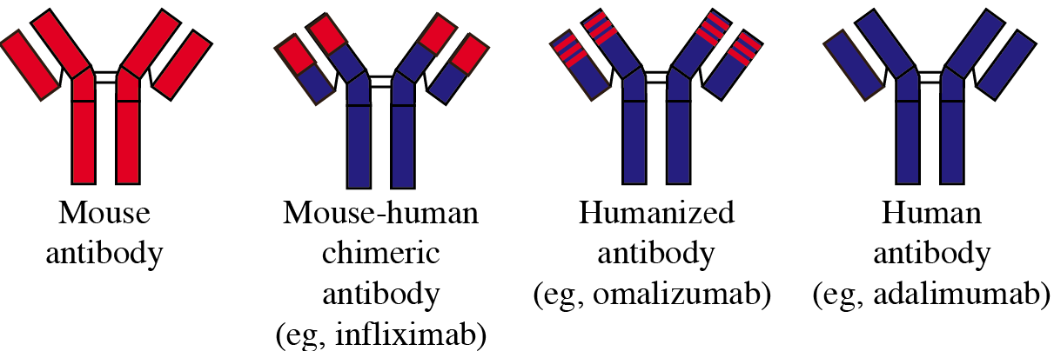
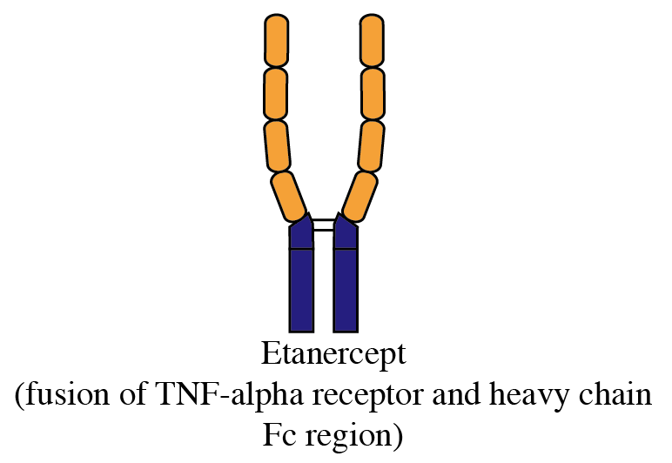
No role in human treatment
(eg, certulizumab)

Slide 9
Mechanism of action

Slide 10
Groups of BRMs
Anti TNF-α
  TNF receptor blockers
  TNF monocloncal antibodies
  TNF production blockers
Anti ILs
  Anti IL-1β
  Anti IL-6
  Anti IL-17
  Anti IL-12, IL-23
Anti T cells (Preventors of T cell activation)
  Anti CD 28
  Anti CD 11
  Anti CD2
Anti B cells
  Anti CD 20
  Anti CD 22
  Anti BLyS
  B cell tolerogen
Anti complement
Kinase inhibitors
  Anti JAK
  Anti SYS
  Anti MAPK

Slide 11
Anti TNF
Directed against TNF-α
Useful for treatment of:
  RA.
  PsA
  AS.
  JIA.
  Adult onset Still’s disease.
  WG.
  ?? SLE
Till now, there are 5 anti-TNF
  Etanercept.
  Infliximab.
  Adalimumab.
  Golimumab.
  Certulizumab.

Slide 12
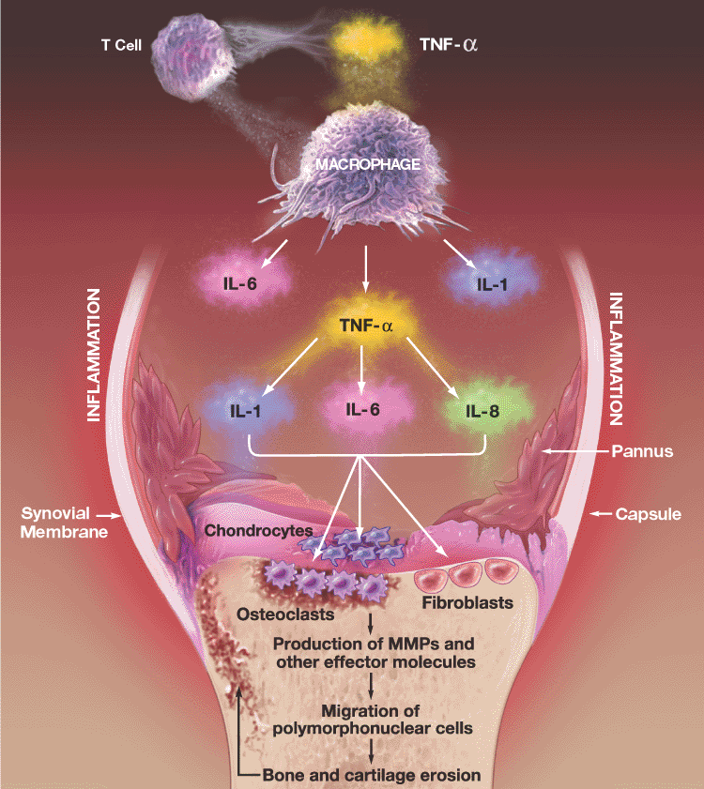

Slide 13
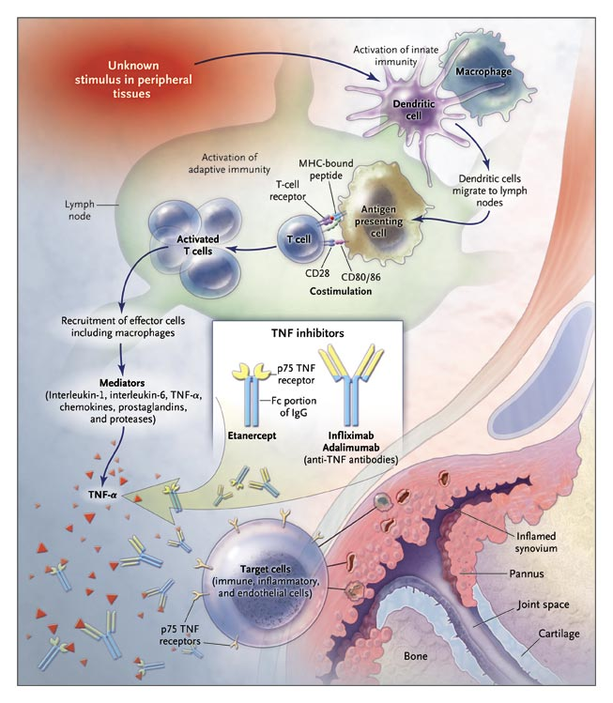

Slide 14
Anti TNF production
Apermilast
  Type 4 phosphodiesterase inhibitor (PDE-4), involved with inhibition of TNF production
  Under trial for RA treatment.

Slide 15
Anti IL-1
They include:
  Anakinra.
  Canakinumab.
Poorly effective in RA, but showing promising results in:
  Acute gouty arthritis.
  Systemic onset JIA.
  ? SLE

Slide 16
Anakinra (Kineret)
Recombinant human IL-1 receptor antagonist
Expressed in E. coli
Amino acid sequence is identical to native human IL-1ra except for the addition of an N-terminal methionine residue
Inhibits the action of IL-1 by competitively blocking the binding of IL-1 to IL-1 receptors on IL-1 responsive target cells
PK studies showed that the terminal half-life of anakinra following SC administration ranges from 3 to 6 hours

Slide 17
Canakinumab
Monoclonal antibody against IL-1 beta
First designed by Novartis in 2012, and first marketed in 2013 in the trade name “Ilaris”
Still under trial.
Thought to be successful in treatment of:
  sJIA
  Gouty arthritis

Slide 18
Anti IL-6
Tocilizumab
Proved to be effective in:
  RA.
  ??? SLE.

Slide 19

IL-6 is Produced by Multiple Cell Types and Is Associated with Numerous Biologic Activities
Monocytes/
macrophages
Endothelial cells
Mesenchymal cells,
fibroblasts/
synoviocytes
T-cell activation
IL-6
Hepatocytes
Acute-phase response
Hepcidin, CRP
↓ CYP450
Maturation of
megakaryocytes
B-cells
Osteoclast activation
Bone resorption
Thrombocytosis
Auto-antibodies (RF)
Hyper-γ-globulinemia

Slide 20
IL-6 Has Numerous Articular Effects in RA
Antibody
production
Synoviocytes
B-cell
IL-6
VEGF
Macrophage
Endothelial cells
Pannus formation
T-cell
Neutrophil
Joint destruction
Osteoclast activation
bone resorption
Mediation of chronic
inflammation

Slide 21
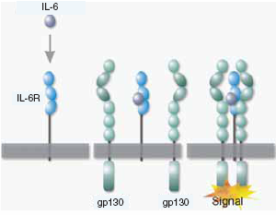
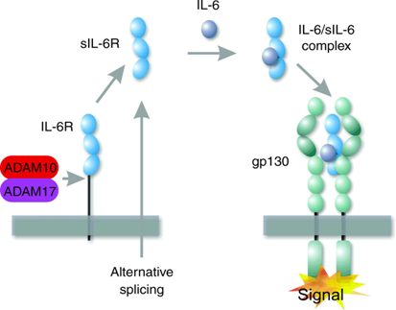
IL-6 Mechanism of Action
Competitive Inhibition by Tocilizumab
Signaling of IL-6 via Membrane Bound and Soluble Receptors
Signaling via the mIL-6R:
Restricted expression on hepatocytes, neutrophils, subsets of T-cells
Trans-signaling via the sIL-6R:
Expands the IL-6 responsiveness to all
cells expressing gp130 signaling complex

Slide 22
Anti IL-6: Tocilizumab
Humanized mAb IgG1
Key Feature:
  Binds soluble and membrane bound IL-6R
Heavy chain
Light chain
CDR region

Slide 23
Anti IL-17
Secukinumab
  Humanized monoclonal antibody against IL-17
  inhibiting migration of macrophages and neutrophils
  Used for Psoriasis and PsA, and may be useful in RA

Slide 24
Anti IL-12, IL-23
Includes:
  Ustekinumab
  Briakinumab
May be useful in PsA.

Slide 25
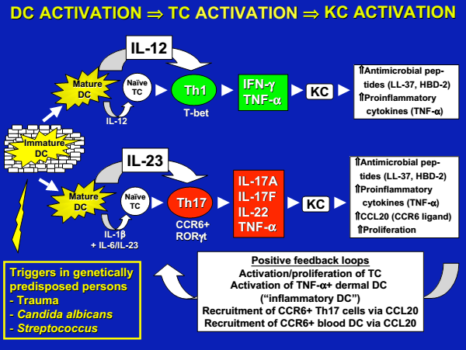
Ustekinumab and Briakinumab
Monoclonal antibody against IL-12 and IL-23

Slide 26
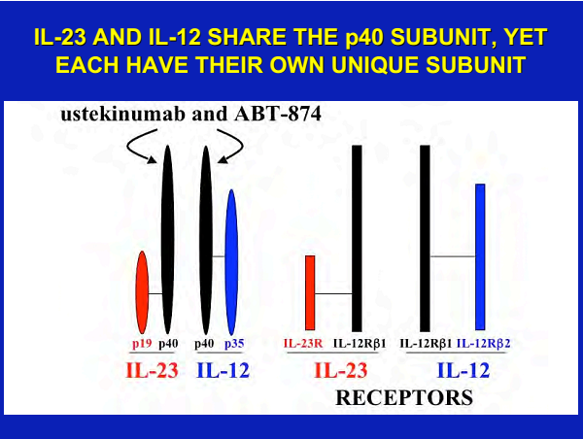

Slide 27
T cell modulation
Abatacept (anti CD 28)
Efalizumab (anti CD 11)
Alefacept (Anti CD 2)

Slide 28
Abatacept
Abatacept
  Fusion protein
  First in the new class of “costimulation blockers” for treatment of RA
  Prevents T-cell activation via binding CD80 and CD86 on antigen-presenting cells
  Useful also for treatment of polyarticular JIA, and may be useful in SLE management.

Slide 29
CTLA4lg (Abatacept) Effectively Blocks CD28 Dependent Costimulatory Signals
Antigen Presenting Cell
T Lymphocyte
Costimulation
Clonal
Proliferation
CD80
CD28
Signal 2
Cytokine
Production
IL-2
IL-4
IL-5
TNF-α
CD86
CD28
Full Activation
CTLA4lg
Signal 1
MHC II
TCR
Antigen specific

Slide 30
Efalizumab
Monoclonal anti CD11a, preventing T cell activation
Effective in Cutaneous SLE manifestations.

Slide 31
Alefacept

Slide 32
Alefacept

Slide 33
Alefacept

Slide 34
Alefacept
Indication
  Alefacept is indicated for the treatment of patients with chronic plaque psoriasis who are candidates for systemic or phototherapy
  Trials are onging for its role in PsA, RA and Scleroderma
Dosing regimen
  Once per week for twelve weeks
    7.5 mg intravenous bolus injection
    15 mg intramuscular injection
  Repeat courses can be given after a twelve week rest period

Slide 35
Anti B cell
Rituximab | Chimeric anti CD 20 monoclonal antibody, preventing proliferation of immature and mature B cells
Veltuzumab | Anti CD 20, preventing proliferation of immature and mature B cells
Ofatumumab
Ocrelizumab
Epratuzumab | Fully humanized anti CD 22
Abetimus | B cell tolerogen (4 dsDNA epitopes)
Edratide | B cell tolerogen
Belimumab | Humanized monoclonal Anti BLyS (B lymphocyte stilmulator) antibody
Atacicept | BLyS blocker

Slide 36
Anti B cell
All are useful in treatment of SLE.
Rituximab: Used in non Hodgkin’s lymphoma, RA and HCV cryoglobulinemia.
Veltuzumab is still under trial.
Ofatumumab is used for CLL and may be used in RA.
Ocrelizumab showed high risk of opportunistic infection, so trials on this drug stopped.

Slide 37
Rituximab: Mechanism of Action
Rituximab initiates complement-mediated
B-cell lysis
Rituximab initiates cell-mediated cytotoxicity via macrophages and
natural killer (NK) cells
Rituximab induces
apoptosis caspase-3,-9
Macrophage
Complement
cascade
B cell
B cell
B-cell lysis
CD20
Rituximab
Apoptosis
Notes:
Comments:
This slide summarises the mechanism of action of Rituximab.
References:
Clynes RA, Towers TL, Presta LG, Ravetch JV. Inhibitory Fc receptors modulate in vivo cytoxicity against tumour targets. Nat Med. 2000;6:443–446.
Reff ME, Carner K, Chambers KS, Chinn PC, Leonard JE et al. Depletion of B cells in vivo by a chimeric mouse human monoclonal antibody to CD20. Blood. 1994;83:435–445.

Slide 38
Anti-complement
Eculizumab
  Monoclonal anti C5 antibody
  Used in:
    Paroxysmal nocturnal hematuria
    May be useful in SLE

Slide 39
Kinase Inhibitors
Includes:
  Anti JAK (Janus Kinase) : Tofacitinib.
    Used in RA
  Anti SYK : Fostamatinib.
    May be useful in Ra, but less effective than anti TNF
  Anti MAPK (Mitogen-activated protein kinase)
    Under trials, did not show promising results in RA treatment

Slide 40
The Janus Kinase (JAK) Family
Currently, there are four known Janus kinases—JAK1, JAK2, JAK3, and TYK2.
JAK3 is restricted to the immune system and is involved in signal transduction of cytokines via signal transducers and activators of transcription.
Tofacitinib, a JAK3 inhibitor originally known as CP-690,550, initially was believed to be highly selective to JAK3.
Several phase II trials are evaluating tofacitinib therapy in the immunosuppressive management of renal transplantation, rheumatoid arthritis, psoriasis, inflammatory bowel disease, and dry eye syndrome.

Slide 41
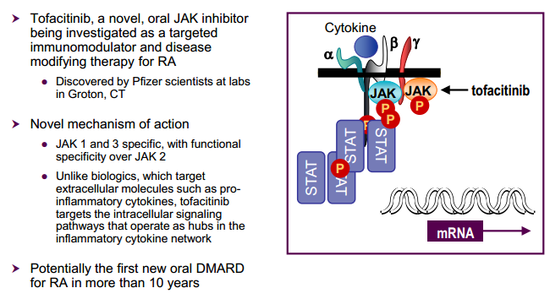
Tofacitinib

Slide 42
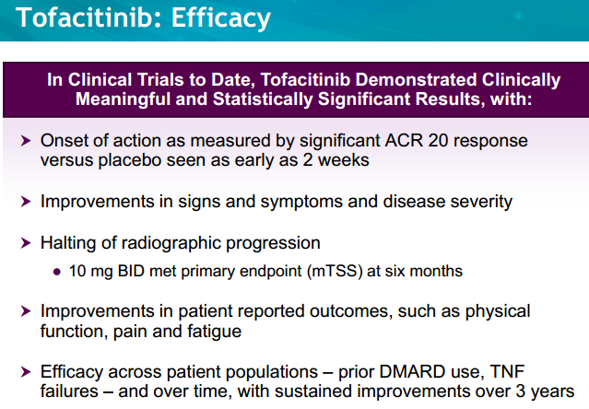
Tofacitinib

Slide 43
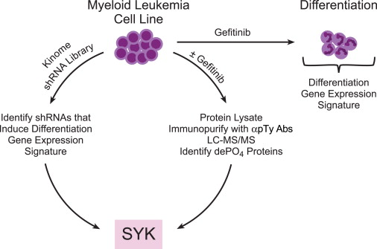
Fostamatinib, Syk inhibitor, shrinks CLL

Slide 44
Biologics in Rheumatic Diseases

Slide 45
Biologics in Rheumatic Diseases
Currently being used in a number of diseases:
  Rheumatoid Arthritis
  Spondyloarthropathies
  Psoriasis
  Vasculitis
  Systemic Lupus Erythematosus
  Gout
  Sarcoidosis
  Multi-system inflammatory diseases

Slide 46
History of DMARD Use
Tocilizumab
Certolizumab and
Golimumab
Rituximab
Abatacept
Adalimumab
Anakinra
Infliximab
Etanercept
Leflunomide
Methotrexate
Penicillamine
Sulfasalazine
Immunosuppressants
Antimalarials
Cortisone
Gold
1930
1940
1950
1960
1970
1980
1990
2000
2013
Notes:
Main Message –Prior therapies for RA were developed for other disease but newer medications are targeting specific molecules identified with disease
Many of the treatments available to patients with rheumatoid arthritis have been used for decades.
Up until quite recently, all the drugs that have been used to modify the disease were actually developed to treat other conditions
Etanercept and leflunomide were approved for treatment of rheumatoid arthritis by the FDA in 1998, and infliximab was approved in 1999.
Anakinra, the newest member of the biologic therapies, targets the effects of IL-1 and was approved in 2001.

Slide 47
Biologics in Rheumatoid Arthritis

Slide 48
Pathogenesis of Rheumatoid Arthritis
Current Treatment
Targets
Rheumatoid
Factors, anti-CCP
Immune complexes
B cell
T cell
Complement
IFN-γ &
HLA
-DR
Neutrophil
Antigen-
presenting
cells
other cytokines
Macrophage
Mast cell
B cell or
macrophage
Synoviocytes
TNFα
IL-1,6
Chondrocytes
Pannus
Osteoclast
Articular
cartilage
Production of collagenase and other
neutral proteases
Bone
Adapted from Arend WP, Dayer JM. Arthritis Rheum. 1990;33:305–15

Slide 49
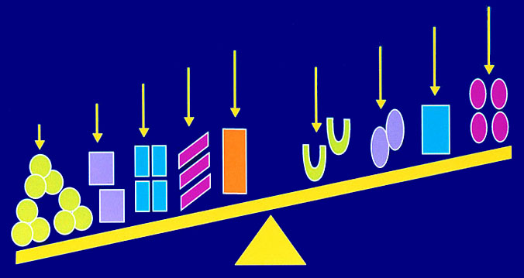
Chronic Inflammation:
Imbalance Between Mediators
IL-10
TGFβ
IFNγ
IL-1Ra
IL-6
IL-4/IL-13
IL-8
IL-1β
TNFα
Anti-inflammatory
Proinflammatory
Notes:
In chronic inflammatory conditions we see an imbalance between mediators of the IR
Upregulation of both pro-inflammatory and anti-inflammatory cytokines
Pro-inflammatory cytokines overwhelming the anti-inflammatory cytokines
Resulting imbalance/tilt

Slide 50
Biologics in Rheumatoid Arthritis
Revolutionized the therapy
Low disease activity or remission is now possible in majority of patients (70-80 %)
Control of radiographic disease/abnormalities
Control of extra-articular manifestations
Marked improvements in disability prevention and work-force productivity
Better quality of Life
Cost-effectiveness???

Slide 51
Spectrum of RA Treatment
NonBiologic Era
Biologic Era
Leflunomide (1998)
MTX
SSZ
HCQ
CQ
Gold
Cyc-A
AZA
PNC
Etanercept(1998)
Rituximab
Infliximab
Abatacept
Golimumab
Certolizumab
(Tocilizumab*)
Adalimumab
Biologic
drug
clinical
trials
Anakinra
1990
2000
‘01
‘03
‘05
‘06
‘09
Year of FDA Approval

Slide 52
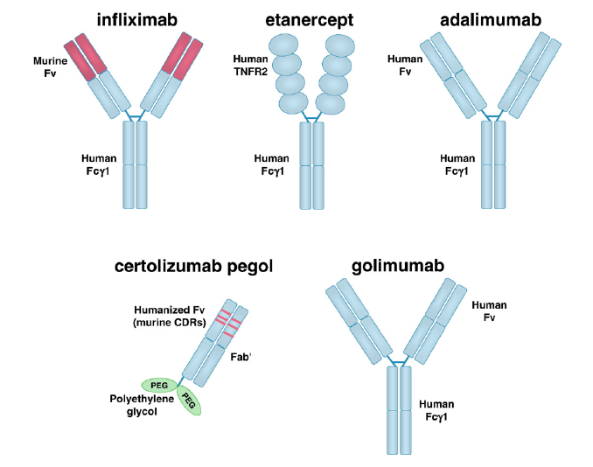
Anti-TNFα Biologics for RA

Slide 53
Drug | Dosage | Onset of Effect | Adverse Events | Monitoring
Adalimumab (Humira) | 40 mg sc every other week | 2-12 weeks | Injection site reaction (ISR), infection risk, TB reactivation Rare: demyelinating disorders | TB, fungal and other infections; CBC and Liver panel (LFTs) at baseline and monthly; thereafter every 2-3 months
Anakinra (Kineret) | 100 mg sc once daily | 4-12 weeks | ISR, leucopenia, Infections, Hypersensitivity | CBC at baseline and every 3 months
Etanercept (Enbrel) | 25 mg sc twice/ week or 50 mg sc weekly | 2-12 weeks | ISR, infection risk, TB reactivation Rare: demyelinating disorders | TB, fungal and other infections; CBC and LFTs at baseline: thereafter every 2-3 months.
Infliximab (Remicade) | 3 mg/kg at weeks 0, 2 and 4 weeks, then every 8 weeks | 2-12 weeks | Infusion reactions, infection risk, TB reactivation Rare: demyelinating disorders | Monitor-TB, fungal and other infections; CBC, Cr and LFTs at baseline and monthly; thereafter every 2-3 months.
Abatacept (Orencia) | 500-1000 mg (weight based) at 0, 2 and 4 & then every 4 weeks | 2-12 weeks | Infusion reactions, infection risk, sepsis, hypersensitivity, COPD exacerbation | Monitor for TB, other infections; CBC and chemistry and LFTs at baseline and with each infusion
Rituximab (Rituxan) | 1000 mg at 0 and 15 days | 2-12 weeks | Infusion reactions, infection risk, reactivation and new viral infections, respiratory difficulty, cytopenia | viral infections, TB, other infections; CBC, chemistry and LFTs at baseline and 2 weeks; thereafter every 2-3 months
Tocilizumab (Actemra) | 4-8 mg/kg every 4 weeks | 2-12 weeks | Infusion reactions, infection risk, reactivation and new viral infections, Lipid abnormalities, cytopenia | Monitor for TB, other infections; CBC and chemistry , Lipid panel and LFTs at baseline and 2 weeks; thereafter every 2-3 months
Certolizumab (Cimzia) & Golimumab (Simponi) | s/c every 2-4 weeks | 2-12 weeks | ISR, infection risk, TB reactivation Rare: demyelinating disorders | TB, fungal and other infections; CBC and LFTs at baseline: thereafter every 2-3 months.

Slide 54
Treatment Strategies in Early RA
Sequential
MONO-Therapy
STEP-UP
Therapy
Initial COMBO
Therapy
Initial BIOLOGIC
Therapy
1.
MTX
MTX
MTX
+ SSZ + PRED
MTX
+ Biologic
2.
SSZ
MTX
+ SSZ
MTX
+ CSA + PRED
SSZ
3.
LEF
MTX
+ SSZ + HCQ
MTX
+ Biologic
LEF
4.
MTX
+ Biologic
MTX + SSZ
+ HCQ + PRED
MTX
+ CSA + PRED
5.
MTX
+ Biologic

Slide 55
Algorithm for Achieving Therapeutic Success in RA
Early RA:
Early DMARD therapy
MTX dose 15-20 mg/week
(within 1-2 months)
+ glucocorticoid
Cobra?
Long-standing RA:
If previosuly inadequate dose:
Optimize DMARD (MTX) dose
+ glucocorticoid
SDAI <3.3 or
DAS28 < 2.4 or
HAQ <0.5
within 4 months by adjusting dosages
X-rays
DAS28 improvement >1.2 or
HAQ improvement >0.5
within 3-4 months
YES
YES
Continue
DMARD therapy, lower corticosteroids
NO
NO
Switch to another DMARD
+ glucocorticoid
Add another DMARD
+ glucocorticoid
or
or
Add a biologic agent (eg, TNF- antagonist)
Add a biologic agent (eg,TNF- antagonist)

Slide 56
Biologics in SLE

Slide 57
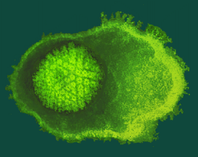
SLE - Etiology
The etiology of SLE remains unknown
Yet, SLE is clearly multifactorial:
      Genetic factors
      Immunologic factors
      Hormonal factors
      Environmental factors
EBV?
Genetic predisposition
Baseline immunological abnormalities
Infection
Hormonal factors
Abnormal (control of) immune responses
SLE

Slide 58
SLE pathogenesis and treatment targets
Stages of autoimmunity
Loss of tolerance
Innate and adaptive dysregulation
End organ targeting
Sle1, CD22, C1q, BANK, BAFF
Sle2 (B), Sle3 (T, DC), PTPN22
FcR, ITGAM
Autoantibodies
Immune complex
BAFF
inhibitors
Proteasome
inhibitors
PC
mBAFF
IFNα
Anti-B cell antibodies
BR3
sBAFF
mDC
TLR
inhibitors
B
TLR9
IFNα
blockade
B7.1/2
B7.1/2
CTLA4-Ig
Abatacept
pDC
CD28
IFNα
CD40
CD40L
T
N
TNFα
IL-1β
IL-6
Lymphocyte signaling
small molecule inhibitors
TNF blockade
IL-6 blockade

Slide 59
Belimumab (anti-BAFF)- Benlysta
for Treatment of SLE
Blocks a B cell survival factor, inducing B cell death
Recently approved (3/9/2011) for the treatment of SLE
  1ST DRUG APPROVED FOR LUPUS IN OVER 50 YRS
  1ST BIOLOGIC APPROVED FOR LUPUS
http://www.youtube.com/watch?v=i24UTvOKK-8

Slide 60
Belimumab (anti-BAFF)- Benlysta
for Treatment of SLE
10 mg/kg IV Q2 wk x3 then Q4 wk
Very good safety profile
Small effect size – improvement in SRI 51% vs 39% = difference of 12%
Slow onset of action
Indicated in SLE patients with active (autoantibody +) disease despite conventional immunosuppressives (like imuran, cellcept, MTX)
Not studied in patients with severe renal or CNS disease nor in combination with cyclophosphamide
Small number of black patients studied

Slide 61
SLE Clinical Trials:
B cell targeted
Targeting B cells with anti-CD20
  Initial studies
  Rituximab in general lupus (Genentech; phase II/III): completed
  Rituximab in proliferative lupus nephritis (LN) (Genentech; phase II/III): completed
Cytokine blockade: BAFF blockade
Other B cell targeted therapeis:
  Anti-CD22: phase II trial promising; phase III EMBODY CURRENTLY ENROLLING
  Anti-CD19

Slide 62
Rituximab= anti-CD20=
B cell depletion
Two large trials of anti-CD20 (rituximab) in SLE failed to meet their primary outcomes
Advances in the field on how to successfully do lupus clinical trials
Rituximab is still thought to be effective in lupus and indicated for a subset of refractory patients

Slide 63
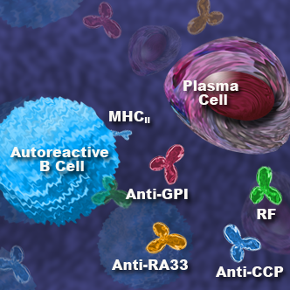
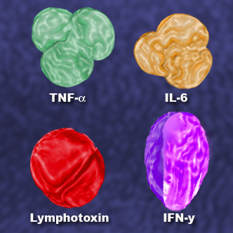
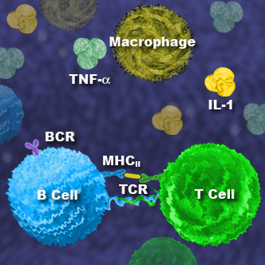
TARGETING B CELLS:
Multiple Roles in autoimmune disease
Autoantibody Dependent:
A variety of autoantibodies are found in patients with autoimmune disease, including SLE and RA
Autoantibody Independent:
Pathogenic cytokines can be directly produced by activated B cells
  TNF-α, IL-6, lymphotoxin, IFNγ
B cells may present antigen to T-cells and also provide costimulatory signals
B cells may form ectopic lymphoid structures and participate in local immune responses

Slide 64
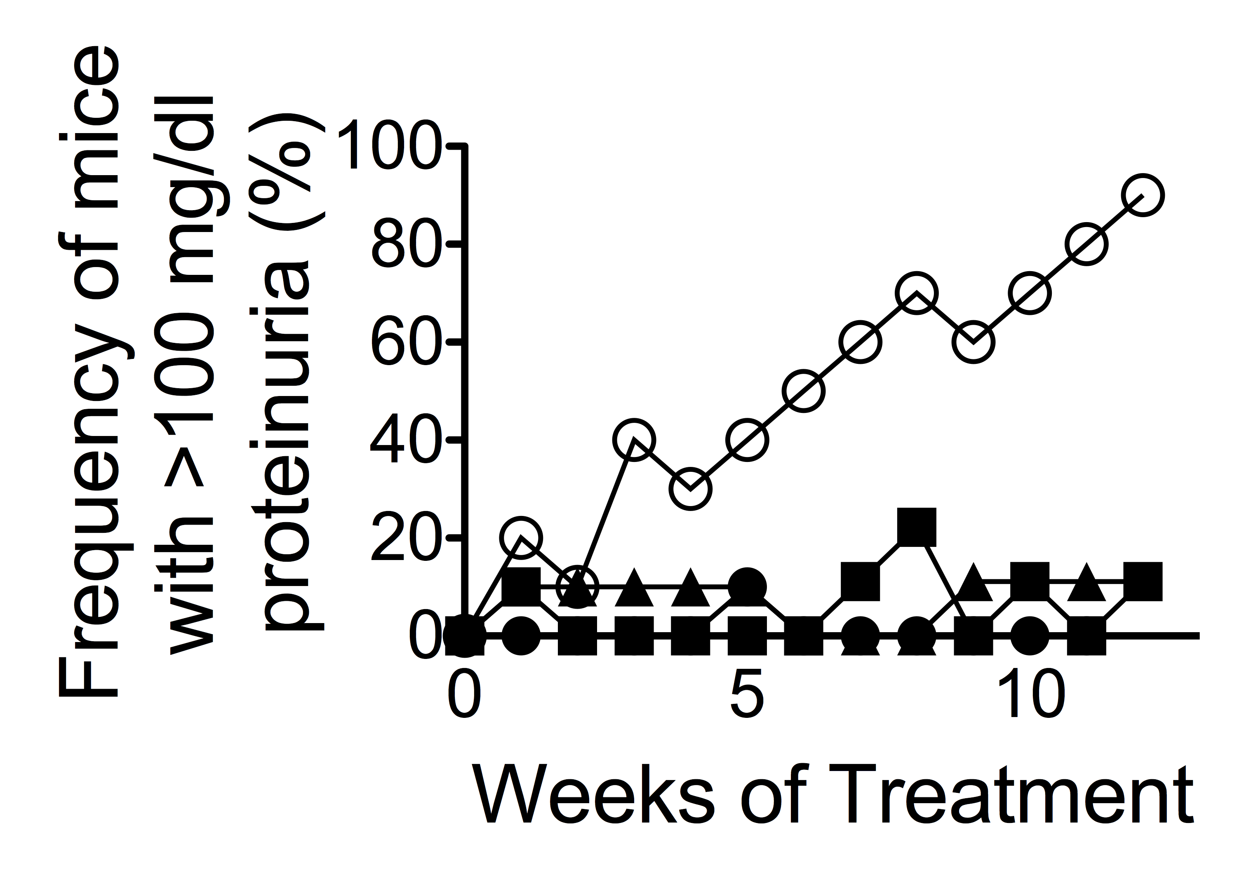
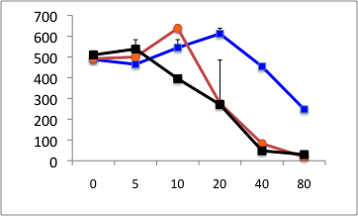
Targeting Plasma Cells
Autontibodies in lupus are frequently pathogenic
Current therapies often do not effectively decrease autoantibodies
Proteasome inhibition
CFZ
PR957
BTZ
No Tx
PIs
IFN-alpha (pg/ml)
Proteasome inhibitor (nM)

Slide 65
SLE Clinical Trials:
Cytokines
Targeting cytokines of pathogenic importance
Targeting Interferon α
  Anti-interferon α (Genentech; phase I): enrollment complete, ROSE
Targeting IL6

Slide 66
Anti-IL6 (Pfizer)
Butterfly study
Well-tolerated in phase I studies in healthy volunteers and subjects with RA (92).
Never used in lupus but similar drug blocking the IL6R (tocilizumab) was well-tolerated in a small number of patients (16) except for reversible neutropenia
Phase 2 study evaluating the safety and efficacy of 3 doses of anti-IL6 compared to PB in 180 SLE patients with moderately active disease (1:1:1:1) (4 doses q8 wk x 24 wk) is underway
  We are currently enrolling

Slide 67
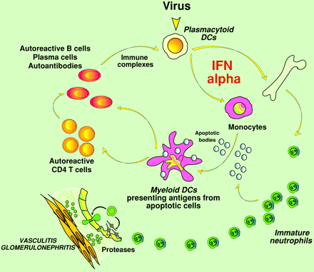
Interferon and Toll-like receptors
TLR

Slide 68
IFN as a common denominator in trigger of flares
Sun exposure
Drug reactions, e.g. sulfa drugs
Infections
Some of our current drugs are now believed to target IFN pathways: e.g. anti-malarials

Slide 69
Anti-IFN
Genentech ROSE study (we participated in this)
Preliminary data to be presented at ACR 2012
  No difference in tx vs. PBO response rates in the group as a whole
  A subset may respond
    SRI response was 55% vs 31% in those on >10 mg prednisone at baseline
    Estimated treatment difference of SRI response in rontalizumab and pbo IFN low arms was 31% (90% CI: 9-51%, p=0.0285).

Slide 70
TLR antagonists
TLRs are key receptors of the innate immune system that can induce strong inflammatory responses- important in production of IFN
Small molecules inhibitors of Toll-like Receptors (TLRs) 7, 8, and/or 9 are under development
Study of DV1179, a bifunctional inhibitor of TLR7 and TLR9, starting in SLE (we will be a site)

Slide 71
Biologics in JIA

Slide 72

Meds: Biologic Agents:
Target against cytokines involved in inflammation: TNF , IL-1Ra, IL-6
Enbrel (Etanercept): approved for JRA
  0.4 mg/kg twice per week SQ injections
  Improvement by third to fourth dose
  Hold for suspected bacterial infection, varicella
  Site reactions
  Binds to TNF

Slide 73
Biologic Agents:
Remicade (Infliximab) - infusion, risk of anaphylaxis, dose may need to be increased depending on response, used in refractory uveitis as well
3 mg/kg IV weeks 0, 2 and 6 (may ⬆ dose to 10 mg/kg)
Improvement can be seen after first dose
Labs every 4-8 weeks (CBC, CMP)
Not approved for children

Slide 74
Biologic Agents:
Anakinra (Kineret) – (blocks IL-1 which stimulates synoviocytes and chondrocytes to produce small inflammatory mediators – leading to cartilage destruction and bone erosions.
  Used in systemic JRA (but not approved)
  Daily, very painful, SQ injections, rotation of sites is important

Slide 75
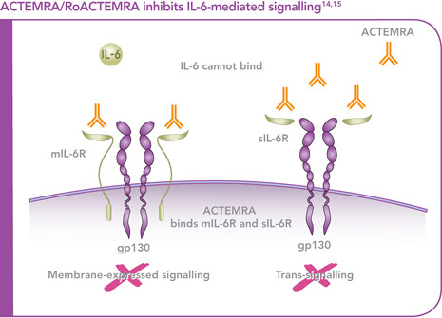
Biologics
Actemra (Tocilizumab) 8 mg/kg
  ACTEMRA is indicated for the treatment of active systemic juvenile idiopathic arthritis in patients 2 years of age and older who have responded inadequately to previously therapy with NSAIDS and steroids.
--Given every 2 weeks by IV, over one hour.
--Dosing interval can be shortened to every week if condition warrants.

Slide 76
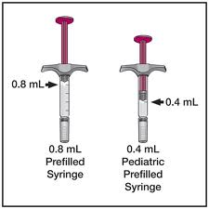
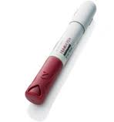
Biologics
Humira (adalimumab) TNF blocker: approved for children ages 4 to 17
Dose: 15mg (33 lbs) to <30 kg (66 lbs): 20 mg every other week
Dose: 30kg or more: 40 mg every other week
Humira pen – or prefilled syringe
Painful injections, but can add lidocaine to buffer the pain (Hershey study).
Can shorten interval to weekly (with auth)

Slide 77
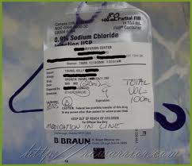
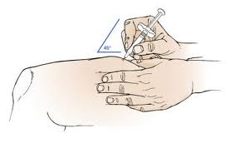
Biologics
Orencia (Abatacept) T-lymphocyte modulator
IV over 30 minutes: at 0, 2 4 weeks, then every 4 weeks
Approved for children 6 and older as monotherapy or with methotrexate
<75 Kg: 10 mg/Kg
If over 75 Kg: follow adult dosing
Approved for adults: weekly SQ self injection

Slide 78
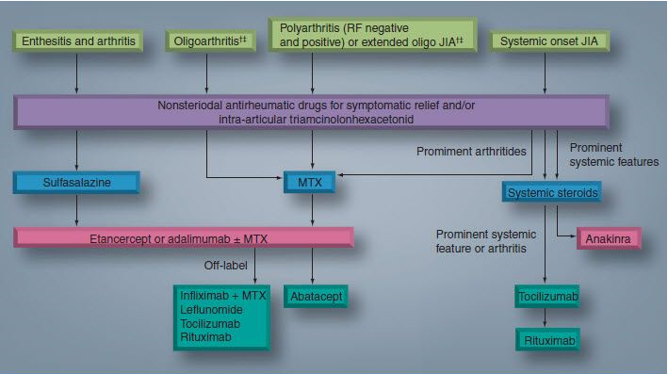

Slide 79
Biologics in AS

Slide 80
Biologics in Ankylosing Spondylitis
Great benefit
Low disease activity or remission is now possible in > 50 % of patients
Control of radiographic disease/abnormalities
Control of extra-articular manifestations (uveitis)
Marked improvements in disability prevention and work-force productivity
Cost-effective

Slide 81
Biologics in Ankylosing Spondylitis
Adalimumab (Humira)
Etanercept (Enbrel)
Infliximab (Remicade)
Tocilizumab (Actemra)
Certolizumab (Cimzia)
Golimumab (Simponi)

Slide 82
Biologics in Psoriasis and Psoriatic arthritis

Slide 83
BIOLOGIC TREAMENTS FOR PSORIASIS/PSORIATIC ARTHRITIS
Alefacept (Amevive®): LFA3-tip, targets CD2+ T cells
Etanercept (Enbrel®): soluble TNF-α receptor
Adalimumab (Humira®): human anti-TNF-α mAb
Infliximab (Remicade®): chimeric anti-TNF-α mAb
Golimumab (Simponi®): human anti-TNF-α mAb
Ustekinumab (Stelara®): human anti-IL-12/IL-23 mAb

Slide 84
APPROXIMATE PASI 75 RESPONSES TO BIOLOGICS AT WEEK 12
Alefacept (Amevive®): 20-25%
Etanercept (Enbrel®): 40-50%
Adalimumab (Humira®): 60-70%
Infliximab (Remicade®): 75-80%
Golimumab (Simponi®): 50%
Ustekinumab (Stelara®): 70% (80% at week 24)

Slide 85
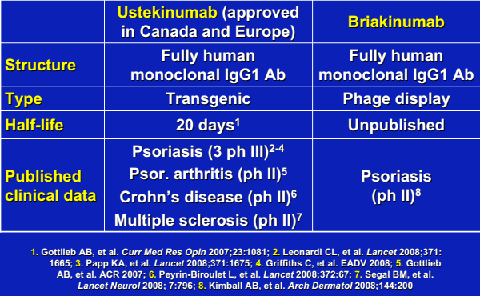

Slide 86
Biologics in Vasculitis

Slide 87
Biologics in Vasculitides
Rituximab- Modest benefit – Non-inferior to the cyclophosphamide in ANCA associated vasculitis.
Other biologics have been used (Case reports/series)
  Adalimumab (Humira)
  Etanercept (Enbrel)
  Infliximab (Remicade)

Slide 88
Biologics in Gout

Slide 89
Biologics in Gout
Biologic uricase agents
Pegloticase (Krystexxa)- approved in 2010, intravenous, pegylated, recombinant, pig-baboon uricase (pegloticase)
Rasburicase- nonpegylated, recombinant, fungal enzyme rasburicase approved for tumor lysis syndrome
Modest benefit
Big issue with immunogenecity and anaphylactoid reactions
Ustekinumab and Briakinumab ➔ under trials for acute gouty arthritis

Slide 90
Biologics in other rheumatic diseases

Slide 91
Biologics in Other rheumatic disorders
Sarcoidosis, reactive arthritides, scleroderma, multi-system inflammatory diseases
  Adalimumab (Humira)
  Etanercept (Enbrel)
  Infliximab (Remicade)
  Tocilizumab (Actemra)
  Certolizumab (Cimzia)
  Golimumab (Simponi)
  Rituximab (Rituxan)

Slide 92
Side effects and contra-indications

Slide 93
Biologics – Common Side-effects
often include
Flu-like symptoms
Rashes
Hematologic effects
Liver function abnormalities
Infections
Malignancy risk

Slide 94
Biologics: Relative Contraindications
Active Hepatitis B Infection
Multiple sclerosis, optic neuritis
Active serious infections
Chronic or recurrent infections
Current neoplasia
History of TB or positive PPD (untreated)
Congestive heart failure (Class III or IV)

Slide 95
Can biologics induce auto-immune disorders?

Slide 96
Autoimmune diseases induced by biologics
SLE or lupus-like syndromes
Vasculitis
Psoriasis
Sardoidosis
Demyelinating CNS Disease
Demyelinating peripheral neuropathies
Antiphospholipid syndrome or APS-like features
Interstitial lung diseases
Ocular Autoimmne Diseases
Autoimmune Hepatitis
Inflammatory myopathies

Slide 97
SLE-Like Disease due to Biologics

Slide 98
Systemic Autoimmune Diseases due to Biologics
Vasculitis
  88% cutaneous
Sarcoidosis
  74% pulmonary, 29% cutaneous
APS
  aPL (+) - 8/13 cases
  Thromboses (30), thrombocytopenia (9), thrombophlebitis (4)
Peripheral Neuropathy
  EMG (n=28, INF)
    ↑amplitude, median nerve; ↓velocity - tibial, sural
ILD
  66% on MTX
    ?Potentiate MTX lung toxicity

Slide 99
Current and future view regarding BRMs

Slide 100
Unmet Needs and Controversies
Cost
Safety
Long-term risk
Length of treatment
Regulation of generics- (Biosimilars)

Slide 101
FDA regulatory role and process
All biologics and blood products are regulated
Balance between safety and improvement in outcomes
No role or ability to regulate cost
Post marketing surveillance
Approval and monitoring quality of biosimilars

Slide 102
Future Direction
> 50 % of future medications (??90 % in immunology and Cancer)
Small molecules- Impact intracellular pathways
Availability of biosimilars

Slide 103
Conclusion
Biological response modifiers, or Biologics have been wonderful additions to physicians ability to improve outcomes in a number of rheumatic and non-rheumatic disorders.
The long term issues of cost-effectiveness and potential adverse effects needs to be closely monitored and periodically assessed.

Slide 104
Take Home Points
Vigilant monitoring is needed for infections, malignancy, infusion/injection reactions, and other safety issues
  Vaccination early into RA treatment should be considered
  TB screening
Risk:benefit should be considered on an individual basis
Biologics are relatively safe, however long-term studies especially for recently approved drugs are needed
Use of biologics in pregnancy/lactation – needs further study

Slide 105
Questions

Slide 106


Slide 107



